Slide 1

EAT-N-DASH
Developed by: Miguel Manuel, Miguel Hernandez, and Luiz Hernandez

Slide 2
Function Implementation
Implemented Functions:
Navigation Menu
User Interface
Admin Interface
Log-in
Order
Cart

Slide 3
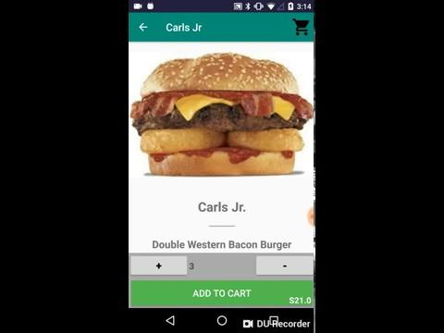
Video Presentation

